Slide 1
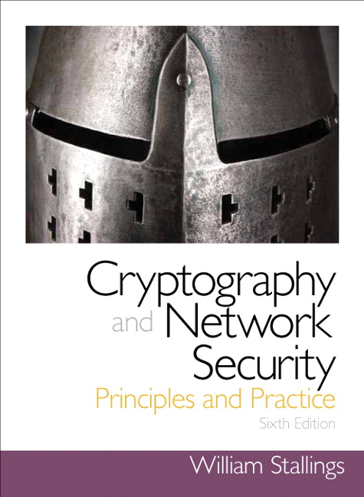
Security
Lecture 2: Block Ciphers
R. Brooks

Slide 2
A few terms
block cipher
block of plaintext is treated as a whole & used to produce a ciphertext block of equal length
typical size: 64 bits
most modern ciphers are block ciphers
stream cipher
digital data is encrypted one bit (or one unit) at a time
In both cases, plaintext is transformed incrementally

Slide 3
Basis of modern ciphers
Claude Shannon (‘45) - information theory
product cipher
perform two or more ciphers in sequence so that result (product) is cryptographically stronger than any component cipher
alternate confusion & diffusion
virtually all significant symmetric block ciphers currently in use are of this type

Slide 4
Shannon’s strategy
thwart cryptanalysis that is based on statistical analysis
hacker has some knowledge of statistical characteristic of plaintext
if statistics are reflected in ciphertext, then analyst may be able to deduce encryption key, or part of it
in Shannon’s ideal cipher, statistics of ciphertext are independent of plaintext

Slide 5
Shannon’s building blocks
confusion
make relation between statistics of ciphertext and the value of the encryption key as complex as possible
S-Boxes -- substitution
providing confusion of input bits
diffusion
diffuse statistical property of plaintext digit across a range of ciphertext digits
i.e. each plaintext digits affects value of many ciphertext digits
P-Boxes -- permutation
providing diffusion across S-box inputs
n rounds of S-P boxes

Slide 6
S-box (substitution)
3 bit
input
3 bit
output
0
1
2
3
4
5
6
7
0
1
2
3
4
5
6
7
0
1
1
1
0
0
Word size of 3 bits => mapping of 2³ = 8 values
Note: mapping can be reversed
Notes:
E(2) → 6 Note that mapping can be reversed

Slide 7
P-box (permutation)
4 bit
input
1
1
1
1
1
0
1
0
1
1
1
1
0
0
1
1
Example 1
Note: reversible
Example 2 - swap two
halves of input
Notes:
Note that mapping can be reversed

Slide 8
S-P networks
alternate S and P boxes
BUT, in practice we must decrypt as well as encrypt
so define the sequence of boxes so that precisely the same system will decrypt as well as encrypt
just run it backwards

Slide 9
Feistel cipher
input plaintext of 2w bits
key K = n sub-keys: K₁, K₂, …, K_{n}
sequence of n “rounds” each using K_{i}
substitution followed by a permutation
apply function F(K_{i}) to right half of data, then exclusive-OR it to left half of data
permutation: interchange two result halves of data
DES is essentially a Feistel cipher

Slide 10
plaintext (2w bits)
L₀
w bits
w bits
R₀
K₁
+
Round 1
F
L₁
. . .
R₁
. . .
K_{n}
+
Round n
F
L_{n}
R_{n}
L_{n+1}
R_{n+1}
ciphertext (2w bits)

Slide 11
Feistel cipher
Multiple rounds
round i input is L_{i-1}, R_{i-1}
L_{i} = R_{i-1}
R_{i} = (L_{i-1} XOR F(R_{i-1} , K_{i}))
L – left portion of intermediate data
R – right …..

Slide 12
Feistel cipher dependencies
block size – increasing size increases security – 64 bits common
key size – increasing size improves security, – 128 bits common
number of rounds – 16 is typical
subkey generation – complex generation makes cryptanalysis harder
round function – complex function is stronger
… but all increases slow the implementation

Slide 13
Feistel decryption
same as encryption, except
ciphertext is input
use keys in reverse order
at each round the output is equal to the corresponding value of the encryption process with the two halves of the value swapped
final permutation (swap) realigns 2 halves

Slide 14
DES Characteristics
Plaintext is 64 bits long
16 rounds
Key length is 56 bits
16 sub-keys generated, one used in each round
DES algorithm is a variant of the Feistel algorithm

Slide 15
One DES Round
<----32 bits------>
<----32 bits------>
L_{i-1}
R_{i-1}
exp/perm to 48
--- 48 bits
--- 48 bits
--- 32 bits
--- 32 bits
x
K_{i}
S-box
permutation
x
L_{i}
R_{i}
Notes:
Single round
R is expanded and permuted from 32 bits to 48 bits
each 4 bit sequence is expanded by adding bit on either side
that bit is taken from blocks to left and right
S-box is substitution that produces 32 bits. S-box is sequence of S minor S-boxes, each of which takes 6 input bits and produces 4 bits.
Each small S-box has a table that is r rows and 16 columns.
First and last bit select row; middle 4 bits select column
output is bit representation in range 0:16
Now have 32 bits coming into permutation
Permutation diffuses output so that in the next round each (small) S-box will be affected

Slide 16
DES cipher
round i input is L_{i-1}, R_{i-1}
L_{i} = R_{i-1}
R_{i} = (L_{i-1} XOR F(R_{i-1} ,K_{i}))

Slide 17
plaintext (64 bits)
56 bit key
init permutation
permute
K1
round 1
perm
left circ shift
K2
round 2
perm
left circ shift
. . .
. . .
Kn
round n
perm
left circ shift
32 bit swap
inverse permutation
ciphertext (64 bits)
Notes:
Initial permutation (and inverse) are defined by tables
Even bits to left and odd bits to right
Each round has permutation and substitution
Key generator
left shifts are 1 and two bits long (actual size is 28 bits)
shifts are governed by a table
each perm is the same

Slide 18
Cryptanalysis of DES
increased computing speed has made a 56 bit key susceptible to exhaustive key search
demonstrated breaks:
1997 – taking a few months, a large network of computers broke DES
1998 – Electronic Frontier Foundation broke DES in a few days on dedicated hardware
1999 – break accomplished in 22 hours

Slide 19
Problem
Same plaintext will yield the same ciphertext when encrypted with the same key
Solution: Modes of operations
Electronic codebook mode (ECB)
Cipher block chaining mode (CBC) – most popular
Output feedback mode (OFB)
Cipher feedback mode (CFB)
Counter mode (CTR)

Slide 20
Cipher Block Chaining (CBC)

Slide 21
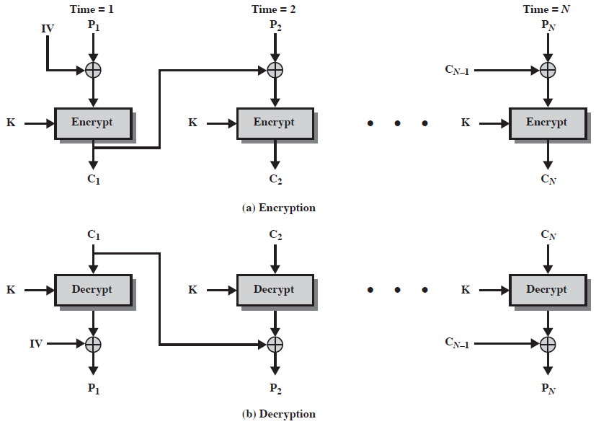
Cipher Block Chaining (CBC)

Slide 22
Remarks on CBC
The encryption of a block depends on the current and all blocks before it.
So, repeated plaintext blocks are encrypted differently.
Initialization Vector (IV)
Must be known to both the sender & receiver
Typically, IV is either a fixed value or is sent encrypted in ECB mode before the rest of ciphertext.

